Slide 1

Perspectives of mentors and mentees on the impact of mentoring relationship characteristics on knowledge production in higher education and science
EUROPEAN CONFERENCE ON SOCIAL NETWORKS (EUSN) 2023
Sara Atanasova, Katja Koren Ošljak, Luka Kronegger
sara.atanasova@fdv.uni-lj.si

Slide 2
INTRODUCTION
Project Mentoring relationships in the processes of scientific collaboration and knowledge production (ARIS J5-3101; head dr. Luka Kronegger)
Mentoring relationship = Scientific collaboration
In mentoring relationship (Csikszentmihalyi, 2009; Mali et al., 2012):
  Achieve common research goal;
  Training new researchers and experts;
  Knowledge exchange;
  New knowledge production.
This study fills the research gap:
  Focuses on both the mentors‘ and mentees' perspectives;
  Explores the mentoring relationship in Slovenian higher education and science;
  Looks into similarities/differences in mentoring relationship in different scientific fields.
Notes:
the mentoring relationship refers to the dynamic and reciprocal collaboration between mentor(s) (usually researchers and professors) and mentee(s) (doctoral students)

Slide 3
AIM of the study and research questions
This study aims to explore the views and perspectives of mentors and mentees regarding the characteristics of mentoring relationships and their impact on knowledge production in higher education and science.
RESEARCH QUESTIONS:
What are the characteristics of mentors and mentees in a mentoring relationship?
What are the differences and similarities in the characteristics of mentors and mentees in a mentoring relationship?
How are the mentoring relationship and the characteristics of mentors and mentees associated to the modes and forms of knowledge production?

Slide 4
DATA COLLECTION AND SAMPLING
The sample frame is based on data from the SICRIS and COBISS databases.
The lists of mentees and mentors are indirectly determined through the list of doctoral dissertations from the databases that meet the following criteria:
  Were completed between 2001 and 2020.
  Have at least one author and at least one mentor with a valid ARIS code.
  Have living authors (they can be retired).
  Authors of these dissertations are not listed in the SICRIS system as researchers in the field of "interdisciplinary research.„
Based on this defined sample frame, a multistage purposive random sampling was conducted.
  1st: A stratified random sampling was performed, where the population was divided into subpopulations so that members of each subpopulation are relatively homogeneous regarding the selected criteria: scientific field & organization & years after completing dissertation (mentees only) & number of mentorships in the last 20 years (mentors only) → 3 mentors and 3 mentees selected for each combination of criteria
  2nd: A simple random sampling was subsequently conducted within fields. Specifically, four units were randomly selected (with equal probability) from each field, along with three additional substitute units. The substitute units were contacted in case the originally selected units were unreachable.
Notes:
The sample frame is based on data from the SICRIS and COBISS data systems, which consist of registration data. Since the subject of the research is mentorship, the lists of mentees and mentors are indirectly determined through the list of doctoral dissertations from the aforementioned data systems. The included doctorates meet the following criteria:
Were completed between 2001 and 2020.
Have at least one author and at least one mentor with a valid ARIS code.
Have living authors (they can be retired).
Authors of these doctorates are not listed in the SICRIS system as researchers in the field of "interdisciplinary research."
The sample frame includes all mentees and mentors (only mentorships are considered, not co-mentorships) listed in doctorates that meet the inclusion criteria. Based on this defined sample frame, a multistage purposive random sampling was conducted. Initially, a stratified random sampling was performed, where the population was divided into subpopulations so that members of each subpopulation are relatively homogeneous regarding the selected factors:
The field in which the doctoral dissertation was completed (all fields according to ARIS classification, except interdisciplinary research).
The organization listed in the COBISS system as the organization where the dissertation was published (including the University of Ljubljana, University of Maribor, International Postgraduate School Jožef Stefan, University of Primorska, Faculty of Applied Social Studies in Nova Gorica, University of Nova Gorica, Alma Mater Europaea).
For the list of mentees, the number of years after completing the doctorate is also considered (three classes are considered: less than 7 years, 7 to 12 years, 13 to 18 years), and for the list of mentors, mentoring experience is defined based on the number of mentorships in the past 20 years (three classes are considered: 1 mentee, 2 to 3 mentees, more than 3 mentees). Gender is an additional criterion (for both mentors and mentees). A list of mentees is prepared first, followed by a list of mentors. Three mentors and three mentees (one selected and two substitutes) are chosen for each combination of factor levels. Individuals included in the mentees' list are not included in the mentors' list.
Since the number of combinations of selected factor levels (252 for mentees and the same for mentors) significantly exceeds the maximum number of interviews that can be conducted (24 interviews), a simple random sampling was subsequently conducted within fields. Specifically, four units were randomly selected (with equal probability) from each field, along with three additional substitute units. The substitute units were contacted in case the originally selected units were unreachable.

Slide 5
DATA Collection & DATA ANALYSIS
Most in-depth semi-structured interviews were conducted online (Zoom), few interviews were conducted in person.
Participants were informed about the nature of the study and signed the informed consent.
Incentive: Faculty of Social Sciences gift bag (in value 13€).
Interviews were audio recorded and transcribed verbatim.
Personal characteristics of the participants were anonimized with the purpose of providing confidentiality.
Average length of the interviews:
  1 hour 7 min (mentees),
  1 hour 8 min (mentors).
Interviews were analyzed using inductive thematic analysis (Braun & Clarke 2006) with Nvivo qualitative data analysis software (version 14).
Saturation was reached after analyzed 21 interviews.

Slide 6
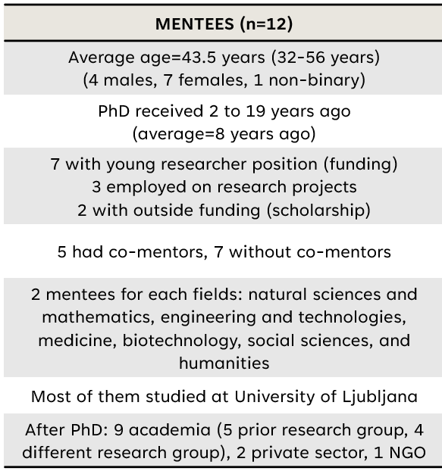
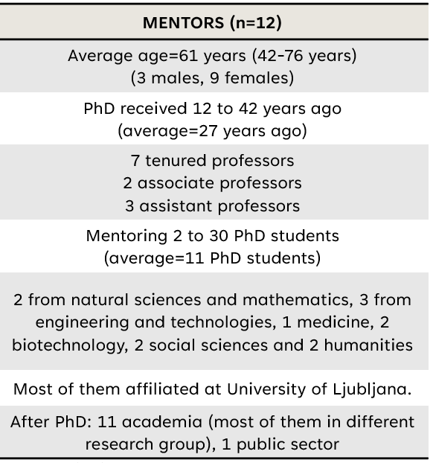
Participant characteristics

Slide 7
Results: identified main themes and subthemes
THEMES | SUBTHEMES (categories)
Mentee‘s types and their characteristics | Mentee types (young researchers; PhD students involved in project; external PhD student) Mentee‘s characteristics (desirable characteristics; undesirable characteristics)
Mentor‘s types and their characteristics | Mentor types (manager; parent mentor; collegial mentor; formal mentor) Mentor‘s characteristics (desirable characteristics; undesirable characteristics)
The role of mentorship in knowledge production process | Knowledge production process (modes of knowledge transfer; implicit knowledge; explicit knowledge) Differences between the types of mentees and mentors in the process of knowledge production Desirable characteristics of mentees and mentors in the process of knowledge production

Slide 8
MENTEE‘S types and their characteristics
Subthemes | Young researchers | PhD students employed on research projects | External PhD students
Emphasized desirable characteristics | Independence Proactiveness Trustworthiness Integrity and non-confrontational Psychological stability Diligence Resourcefulness Motivation Precision and meeting deadlines Confidence | Proactiveness Independence Persistence Diligence Motivation Precision and meeting deadlines Psychological stability Confidence | Resourcefulness Independence Psychological stability Integrity and non-confrontational Diligence Good prior knowledge and competences Motivation Persistence
Emphasized undesirable characteristics | Lack of knowledge and competences | Lack of knowledge and competences | Lack of knowledge and competences
"I received a salary as a young researcher, which seemed quite favourable to me, taking care of the material aspect, expenses, and also for the occasional conference, so it was quite favourable, and I didn't worry about the salary, as the salary was within that." (DR8)
"For quite some time, I thought whether I should enrol in a doctoral program or not, precisely because I didn't see prospects for employment in the field of science and research, within academia, I truly didn't see a perspective here. Then I made the decision…" (DR1)

Slide 9
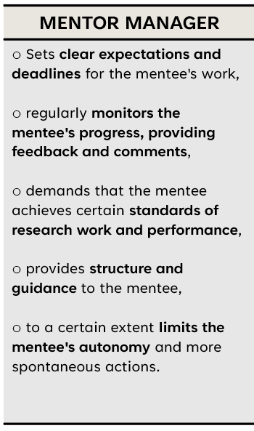
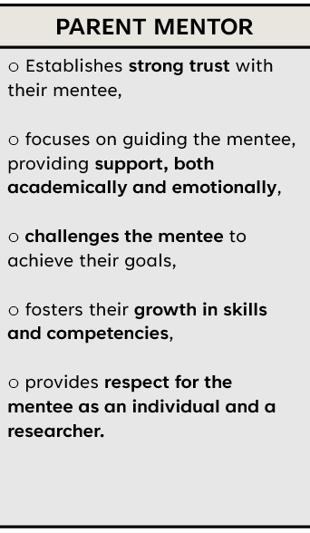
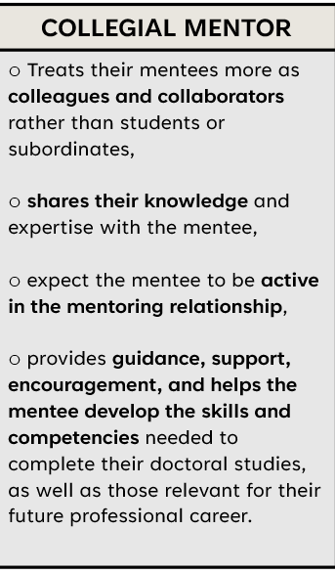
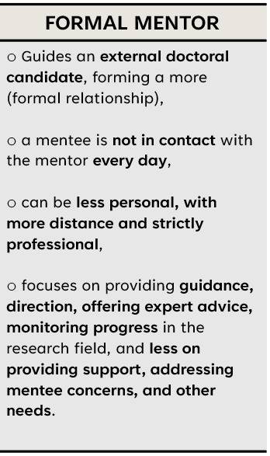
Mentor‘s types and their Characteristics
"As a mother. That's how I always treated them, as if they were my children. No different, not at all. To say that I saw someone and thought, 'Oh, I like this one' or something like that, absolutely not. Just like when I had two adult daughters, both studying [study fields], so, at least from my side, it seemed completely natural to me that they are like my children…“ (M7)
"I would say that, at least for myself, I can claim that I've always been interested in how they approach issues that are problems for me as well, or how they tackle something that I haven't dealt with, and somewhere it still falls within the scope of my competencies or my knowledge. In short, mentoring has always seemed to me not to lead someone who is ignorant. I mean, I'm in a position of knowledge, so you have to follow me, but it's really an interaction where both partners are active." (M4)

Slide 10
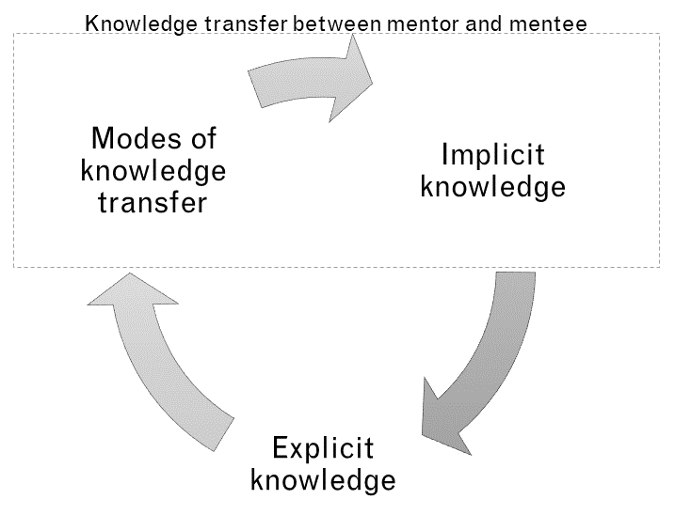
Knowledge production process in mentoring relationship
Administrative work
International exchanges
Additional education
Conference exchanges
Project-based (international) collaboration
Informal socializing with researchers
Collaborative writing of research reports
Discussion and brainstorming
Reading relevant (scientific) literature
Pedagogical training
Co-authoring articles
Teamwork
Data collection and analysis
Communication skills
Organizational skills
Computer and digital skills
General methodological skills
Data analysis and interpretation skills
Skills in structuring and planning research
Critical thinking skills
Article writing and publishing skills
Teaching and instructing skills
Skills in project management
Databases, monographs/books, articles, patents, conference presentations, posters, project proposals, research reports, research & scientific results, prepared lectures and lab plans, diplomas/master's theses, and applications/interfaces.
Notes:
Projektno (mednarodno) sodelovanje
Komunikacijske veščine
Organizacijske veščine
Splošne metodološke veščine
Računalniške in digitalne veščine
Veščine analiziranja in interpretacije podatkov
Veščine pisanja člankov in njihove objave
Veščine o delovanju in vodenju projektov
Veščine poučevanja in učenja drugih
Baze podatkov
Članki
Projektne prijave
Predstavitve na konferencah
Raziskovalna poročila
Raziskovalno znanstveni rezultati
Patenti
Aplikacije/vmesniki

Slide 11
Differences between the types of mentees and mentors in the process of knowledge production
Certain modes of knowledge transfer occur exclusively among specific types of mentors and mentees → limited for certain types of mentees:
Specific modes of knowledge transfer are reserved only within certain types of mentorships:
  Administrative work was highlighted more by parental and collegial mentors, and it is predominantly performed by young researchers.
  Young researchers are also more involved in pedagogical training → they acquire teaching and instructing skills, leading them to prepared lectures and exercise plans, while PhD students employed on projects are less engaged in this process.
  External PhD students are not beneficiaries of such forms of knowledge production.
Formal mentors, to a lesser extent or not at all, send their external PhD students for additional education, do not involve them in project-based (international) collaboration, do not co-author research reports with them, and do not provide pedagogical training.
External PhD students lack the opportunity to acquire certain implicit/tacit knowledge (e.g., project operation and management skills, teaching and instructing skills).
Limits their production of certain explicit knowledge (e.g., research reports, project proposals, diplomas/master's theses, prepared lectures, and exercise plans).
Notes:
The analysis also revealed that differences exist among types of mentees and mentors in the knowledge production process. We found that certain modes of knowledge transfer occur exclusively among specific types of mentors and mentees, meaning that some knowledge transfer methods, along with acquired implicit/tacit and explicit knowledge, are limited for certain types of mentees. Formal mentors, to a lesser extent or not at all, send their external doctoral candidates for additional education, do not involve them in project-based (international) collaboration, do not co-author research reports with them (possibly due to the fact that external candidates do not participate in projects and other practices that would require research reports), and do not provide pedagogical training. As a result, external doctoral candidates lack the opportunity to acquire certain implicit/tacit knowledge (e.g., project operation and management skills, teaching and instructing skills), which also limits their production of certain explicit knowledge (e.g., research reports, project proposals, diplomas/master's theses, prepared lectures, and exercise plans). On the other hand, as the results indicated, specific modes of knowledge transfer are reserved only within certain types of mentors. For example, administrative work was highlighted more by parental and collegial mentors, and it is predominantly performed by young researchers. Young researchers are also more involved in pedagogical training. Through this, they acquire teaching and instructing skills, leading them to prepared lectures and exercise plans, while doctoral candidates employed on projects are less engaged in this process. External candidates, as previously reported, are not beneficiaries of such forms of knowledge production.

Slide 12
Desirable characteristics of mentees and mentors in the process of knowledge production
Mentors and mentees frequently mentioned specific desirable characteristics of mentees and mentors when describing certain knowledge production processes:
  FACILITATORS OF KNOWLEDGE PRODUCTION PROCESS - importantly contribute to various forms of knowledge transfer, both implicit/tacit and explicit knowledge exchanged in the mentoring relationship.
Desirable mentees‘ characteristics | Desirable mentors‘ characteristics
Independence Proactiveness Diligence Good prior knowledge and competencies Psychological stability Motivation Persistance Trustworthiness Precision and meeting deadlines | Emotional support Promoting international collaboration and networking Providing professional advice and assistance Promoting writing and publishing articles Listening Trustworthiness
Notes:
We have also found through the analysis of interviews that mentors and mentees more frequently mentioned specific desirable characteristics of mentees and mentors when describing certain knowledge production processes. From this perspective, they could be labeled as promoting factors in the knowledge production process, as they largely contribute to various forms of knowledge transfer, both implicit/tacit and explicit knowledge exchanged in the mentoring relationship. We found that for mentees, the following key characteristics were highlighted (Table 12): independence, self-initiative, industriousness, strong prior knowledge and competencies, psychological stability, motivation, persistence, trustworthiness, precision, and meeting deadlines. On the other hand, the following key characteristics were emphasized for mentors (Table 12): emotional support during doctoral studies and dissertation preparation, encouragement of international collaboration and networking, providing expert advice and assistance, openness, promoting writing and article publication, active listening, and being trustworthy. The analysis did not reveal a pattern of reporting similar undesirable characteristics of both actors that hinder or restrict the knowledge production process. Thus, we found that the desirable characteristics of mentees and mentors are more closely linked to the knowledge production process, as they encourage more intensive knowledge transfer between the mentor and mentee and lead more effectively to exp
licit forms of knowledge.

Slide 13
Conclusion
The formal position and status of PhD students not only play an important role in the experience of doctoral study, but also affect the process of knowledge production.
Mentor characteristics have a large impact on mentees' experiences:
Managers are great leaders, but can also be too controlling.
Parent mentors provide good support (professional and personal) and care about the mentee, but can also be overbearing and overprotective.
Collegial mentors give their mentees support, autonomy and freedom, but can also give inadequate guidance and are unreliable.
Formal mentors provide the necessary guidance, but mentees lack opportunities to acquire certain tacit knowledge, which also limits their explicit knowledge production.
Project-based (international) collaboration, co-authoring articles, discussions and brainstorming lead to the development of the most extensive set of tacit knowledge, which leads to more explicit knowledge.
We found that some desirable characteristics of mentees and mentors are more closely related to the process of knowledge production, as they promote more intensive knowledge transfer between mentor and mentee and lead more effectively to explicit forms of knowledge.
Future plans: Online survey & combination of results from SNA, qualitative study and online survey.

Slide 14
THANK YOU
sara.atanasova@fdv.uni-lj.si

Slide 15
Mentor‘s types and their DESIRABLE characteristics
Subthemes | Manager | Parent mentor | Collegial mentor | Formal mentor
Emphasized desirable characteristics | Problem-solving and willingness to take risks Openness and accessibility Promoting of international collaboration and networking Promoting writing and publishing articles Providing professional advice and assistance Trustworthiness Transparency in the distribution of work and credit for it | Emotional support Openness and accessibility Friendliness and humanity Shared decision-making Promoting international collaboration and networking Promoting writing and publishing articles Respectfulness Providing professional advice and assistance Career path guidance Trustworthiness Transparency in the distribution of work and credit for it | Informal socializing Emotional support Problem-solving and willingness to take risks Openness and accessibility Listening Friendliness and humanity Shared decision-making Promoting writing and publishing articles Respectfulness Providing professional advice and assistance Career path advising Trustworthiness Transparency in the distribution of work and credit for it | Personal compatibility Respectfulness Providing professional advice and assistance Trustworthiness

Slide 16
Mentor‘s types and their LESS DESIRABLE Characteristics
"Hmm, yeah, I think in the end, he just got too involved in this micro-management and control, which didn't seem like a good practice to me... in the end, he wanted to control too much, even my, you know, private life eventually. For example, at that time, I was quite active on Twitter, and he actually went to read my Twitter and calculated how many tweets I posted per day, which isn't actually a high number. But to him, it seemed like a lot, and he started meddling in things he shouldn't have. Things that weren't his concern, he as an employer, as a mentor, doesn't have the right to interfere so much in my personal decisions.„ (DR4)
Subthemes | Manager | Parent mentor | Collegial mentor | Formal mentor
Emphasized undesirable characteristics | Interference and monitoring Ambiguous messages and responses to work Authority Complicated personality Indecisiveness Resistance to new ideas Doing the work instead of them Lack of praise and encouragement Age and work style differences | Interference and monitoring Resistance to new ideas Exclusion from the research group | Ambiguous messages and responses to work Lack of transparency in work Unreliability Lack of expertise Inadequate guidance and leadership Insufficient guidance towards international collaboration and networking | Exclusion from the research group Insufficient guidance towards international collaboration and networking
"We also never-, there was never a discussion about maybe preparing a research project together, or in that sense, no. Maybe in the future, I don't know... For instance, I wasn't at all involved in the institution's environment where I did my doctorate, as I said, I'm more in the institution where I studied my primary field, so yeah, yeah, you see the difference. Nobody knows me there, at the doctoral level..." (DR1)

Slide 17
Mentor‘s types and their Characteristics
MENTOR MANAGER | PARENT MENTOR | COLLEGIAL MENTOR | FORMAL MENTOR
Sets clear expectations and deadlines for the mentee's work, regularly monitors the mentee's progress, providing feedback and comments, demands that the mentee achieves certain standards of research work and performance, provides structure and guidance to the mentee, to a certain extent limits the mentee's autonomy and more spontaneous actions. | Establishes strong trust with their mentee, focuses on guiding the mentee, providing support, both academically and emotionally, challenges the mentee to achieve their goals, fosters their growth in skills and competencies, provides respect for the mentee as an individual and a researcher. | Treats their mentees more as colleagues and collaborators rather than students or subordinates, shares their knowledge and expertise with the mentee, expect the mentee to be active in the mentoring relationship, provides guidance, support, encouragement, and helps the mentee develop the skills and competencies needed to complete their doctoral studies, as well as those relevant for their future professional career. | Guides an external doctoral candidate, forming a more (formal relationship), a mentee is not in contact with the mentor every day, can be less personal, with more distance and strictly professional, focuses on providing guidance, direction, offering expert advice, monitoring progress in the research field, and less on providing support, addressing mentee concerns, and other needs.

Slide 18
Mentor‘s types and their Characteristics: Manager
"Hmm, yeah, I think in the end, he just got too involved in this micro-management and control, which didn't seem like a good practice to me... in the end, he wanted to control too much, even my, you know, private life eventually. For example, at that time, I was quite active on Twitter, and he actually went to read my Twitter and calculated how many tweets I posted per day, which isn't actually a high number. But to him, it seemed like a lot, and he started meddling in things he shouldn't have. Things that weren't his concern, he as an employer, as a mentor, doesn't have the right to interfere so much in my personal decisions.„ (DR4)
Mentor manager is a mentor who:
  sets clear expectations and deadlines for the mentee's work,
  regularly monitors the mentee's progress, providing feedback and comments,
  demands that the mentee achieves certain standards of research work and performance,
  provides structure and guidance to the mentee,
  to a certain extent limits the mentee's autonomy and more spontaneous actions.
Desirable characteristics | Undesirable characteristics
Problem-solving and willingness to take risks Openness and accessibility Promoting international collaboration and networking Promoting writing and publishing articles Providing professional advice and assistance Trustworthiness Transparency in the distribution of work and credit for it | Interference and monitoring Ambiguous messages and responses to work Authority Complicated personality Indecisiveness Resistance to new ideas Doing the work instead of them Lack of praise and encouragement Age and work style differences
Notes:
Mentorira vse tipe mentorirancev, manj zastopan na področjih humanistike.

Slide 19
Mentor‘s types and their Characteristics: PARENT MENTOR
"As a mother. That's how I always treated them, as if they were my children. No different, not at all. To say that I saw someone and thought, 'Oh, I like this one' or something like that, absolutely not. Just like when I had two adult daughters, both studying [study fields], so, at least from my side, it seemed completely natural to me that they are like my children…“ (M7)
Parent mentor is a mentor who:
  establishes strong trust with their mentee,
  focuses on guiding the mentee, providing support, both academically and emotionally,
  challenges the mentee to achieve their goals,
  fosters their growth in skills and competencies,
  provides respect for the mentee as an individual and a researcher.
Desirable characteristics | Undesirable characteristics
Emotional support Openness and accessibility Friendliness and humanity Shared decision-making Promoting international collaboration and networking Promoting writing and publishing articles Respectfulness Providing professional advice and assistance Career path guidance Trustworthiness Transparency in the distribution of work and credit for it | Interference and monitoring Resistance to new ideas Exclusion from the research group
Notes:
Th second type of mentor is the parental mentor, where the mentor-mentee relationship, as the name suggests, exhibits some characteristics of a parent-child relationship.
Some mentees and mentors have referred to their mentor or themselves as a "mom" or "dad," symbolizing a role model, a source of reliability and trust, guidance, support, and opportunities for advancement for the mentee.
As the results have shown, parental mentors are more likely to collaborate with mentees who are young researchers or doctoral candidates employed on research projects, often acquiring mentees through the continuation of previous joint work (e.g., mentoring during undergraduate or master's studies, prior collaboration on projects, or internships).

Slide 20
Mentor‘s types and their Characteristics: COLLEGIAL MENTOR
Collegial mentor is mentor who:
  treats their mentees more as colleagues and collaborators rather than students or subordinates,
  share their knowledge and expertise with the mentee,
  expect the mentee to be active in the mentoring relationship,
  provides guidance, support, encouragement, and helps the mentee develop the skills and
  competencies needed to complete their doctoral studies, as well as those relevant for their future
  professional career.
"I would say that, at least for myself, I can claim that I've always been interested in how they approach issues that are problems for me as well, or how they tackle something that I haven't dealt with, and somewhere it still falls within the scope of my competencies or my knowledge. In short, mentoring has always seemed to me not to lead someone who is ignorant. I mean, I'm in a position of knowledge, so you have to follow me, but it's really an interaction where both partners are active." (M4)
Desirable characteristics | Undesirable characteristics
Informal socializing Emotional support Problem-solving and willingness to take risks Openness and accessibility Listening Friendliness and humanity Shared decision-making Promoting writing and publishing articles Respectfulness Providing professional advice and assistance Career path advising Trustworthiness Transparency in the distribution of work and credit for it | Ambiguous messages and responses to work Lack of transparency in work Unreliability Lack of expertise Inadequate guidance and leadership Insufficient guidance towards international collaboration and networking
Notes:
Collegial mentors predominantly collaborate with mentees who are young researchers. Their collaboration with mentees is often established based on the expressed interest from the mentee or through the continuation of previous joint collaboration.

Slide 21
Mentor‘s types and their Characteristics: FORMAL MENTOR
Formal mentorship:
  Is established when a mentor guides an external doctoral candidate, forming a more (formal relationship),
  a mentee is not in contact with the mentor every day,
  can be less personal, with more distance and strictly professional,
  the mentor focuses on providing guidance, direction, offering expert advice, monitoring progress in the research field, and less on providing support, addressing mentee concerns, and other needs.
"We also never-, there was never a discussion about maybe preparing a research project together, or in that sense, no. Maybe in the future, I don't know... For instance, I wasn't at all involved in the institution's environment where I did my doctorate, as I said, I'm more in the institution where I studied my primary field, so yeah, yeah, you see the difference. Nobody knows me there, at the doctoral level..." (DR1)
Desirable characteristics | Undesirable characteristics
Personal compatibility Respectfulness Providing professional advice and assistance Trustworthiness | Exclusion from the research group Insufficient guidance towards international collaboration and networking
Notes:
Interestingly, this type of mentorship was highlighted only in the fields of social sciences and humanities, where mentees entered such a mentoring relationship through their own initiative and expressed desire to pursue their doctorate under a specific mentor.

Slide 22
Participant characteristics
MENTEES (n=12) | MENTORS (n=12)
Average age=43.5 years (32-56 years) (4 males, 7 females, 1 non-binary) | Average age=61 years (42-76 years) (3 males, 9 females)
PhD received 2 to 19 years ago (average=8 years ago) | PhD received 12 to 42 years ago (average=27 years ago)
7 with young researcher position (funding) 3 employed on research projects 2 with outside funding (scholarship) | 7 tenured professors 2 associate professors 3 assistant professors
5 had co-mentors, 7 without co-mentors | Mentoring 2 to 30 PhD students (average=11 PhD students)
2 mentees for each fields: natural sciences and mathematics, engineering and technologies, medicine, biotechnology, social sciences, and humanities | 2 from natural sciences and mathematics, 3 from engineering and technologies, 1 medicine, 2 biotechnology, 2 social sciences and 2 humanities
Most of them studied at University of Ljubljana | Most of them affiliated at University of Ljubljana.
After PhD: 9 academia (5 prior research group, 4 different research group), 2 private sector, 1 NGO | After PhD: 11 academia (most of them in different research group), 1 public sector

Slide 23
Knowledge production process in mentoring relationship
"I was exposed to researcher upbringing, I would say. And about writing articles... For example, I prepared a draft of an article, which seemed okay to me, and then the two of them refined it, and I saw what aspects I still needed to pay attention to. In this way, but also essentially from the process of preparing the article, submitting it, revisions, reviews, and so on..." (DR10)
"Discussions, yes. Okay, even when you're writing a project or when you're thinking about something, and then a spark hits you, and you say, okay, we need to discuss this. For me, especially like that, we talk, or I read something, ... But it's always that the decisions are made during the meetings when we talk. We somehow decide where to go next." (M5)
Administrative work
International exchanges
Additional education
Conference exchanges
Project-based (international) collaboration
Informal socializing with researchers
Collaborative writing of research reports
Discussion and brainstorming
Reading relevant (scientific) literature
Pedagogical training
Co-authoring articles
Teamwork
Data collection and analysis
Communication skills
Organizational skills
Computer and digital skills
General methodological skills
Data analysis and interpretation skills
Skills in structuring and planning research
Critical thinking skills
Article writing and publishing skills
Teaching and instructing skills
Skills in project management
Databases, monographs/books, articles, patents, conference presentations, posters, project proposals, research reports, research & scientific results, prepared lectures and lab plans, diplomas/master's theses, and applications/interfaces.
Notes:
Projektno (mednarodno) sodelovanje
Komunikacijske veščine
Organizacijske veščine
Splošne metodološke veščine
Računalniške in digitalne veščine
Veščine analiziranja in interpretacije podatkov
Veščine pisanja člankov in njihove objave
Veščine o delovanju in vodenju projektov
Veščine poučevanja in učenja drugih
Baze podatkov
Članki
Projektne prijave
Predstavitve na konferencah
Raziskovalna poročila
Raziskovalno znanstveni rezultati
Patenti
Aplikacije/vmesniki

